Slide 1
Neurodata MRI to Graphs (NDMG)
Derek Pisner, Alex Loftus, and Ross Lawrence
08/19/2019

Slide 2
A brief overview of diffusion MRI (dMRI)

Slide 3
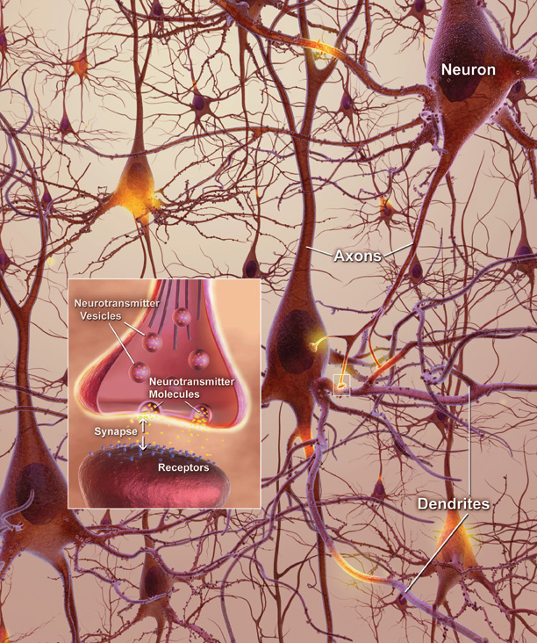


White-matter imaging as a study of microstructural connectivity
Axons measure ~μm in width
They group together in bundles that traverse the white matter
We cannot image individual axons but we can image bundles (i.e. and more broadly fascicles) with dMRI
Useful in studying neurodegenerative diseases, stroke, aging, development…
$$?$$
$$≈$$
Notes:
white matter is composed of both myelinated and unmyelinated axons, blood vessels, and all major types of glia.

Slide 4
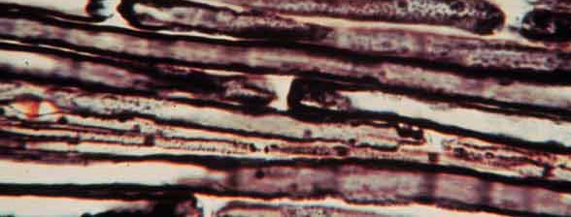
Diffusion in brain tissue
Differentiate tissues based on the diffusion (random motion) of water molecules within them
Gray matter: Diffusion is uniformly restricted
⇒ isotropic
White matter: Diffusion is preferentially restricted
⇒ anisotropic
Notes:
The architecture of the axons in parallel bundles and their myelin shield facilitate the diffusion of the water molecules along their main direction. myelin sheath surrounding an axon restricts the diffusion of water perpendicular to the axon, while allowing relatively free diffusion of water parallel to the axon.
Water molecules, in our body, undergo random translational motion. In physics, this motion is called "Brownian Motion", or simply "Diffusion". If we apply special diffusion-encoding gradients, the magnetic resonance (MR) images can be made sensitive to this motion.

Slide 5
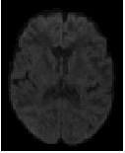
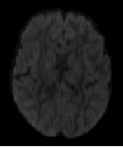
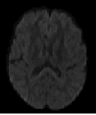
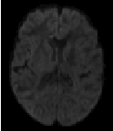
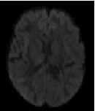
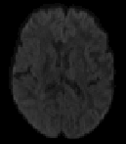
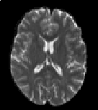
Diffusion MRI
Diffusion encoding in direction d₁
Magnetic resonance imaging can provide “diffusion encoding”
Magnetic field strength is varied by gradients in different directions
Image intensity is attenuated depending on water diffusion in each direction
Compare with reference image(s) to infer diffusion relative to non-diffusion signal
d₂
d₃
d₄
d₅
d₆
No diffusion encoding
Notes:
The sample (a brain) is placed in a strong magnetic field
Protons are magnetized and align with the field
The protons are excited through application of RF pulses
Magnetic field gradients are applied across the sample to select and to modulate the magnetization
Coils are used to detect the change in magnetization of the sample (in a spatially selective manner).

Slide 6
Acquiring diffusion MRI requires some important choices

Slide 7

Choice 1: Gradient directions

Slide 8
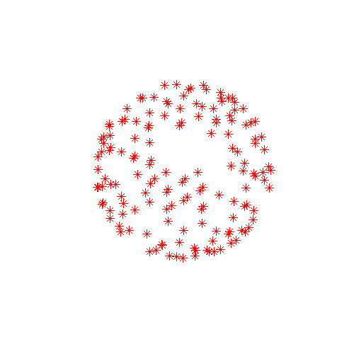
How many directions?
Acquiring data with more gradient directions leads to:
More reliable estimation of diffusion measures
Increased imaging time ⇒ Subject discomfort, more susceptible to artifacts due to motion, respiration, etc.
DTI:
Six directions is the minimum
Usually a few 10’s of directions
Diminishing returns after a certain number [Jones, 2004]
DSI:
Usually few 100’s of directions

Slide 9
Choice 2: The b-values
The b-value depends on acquisition parameters:
b = γ² G² δ² (Δ - δ/3)
γ the gyromagnetic ratio
G the strength of the diffusion-encoding gradient
δ the duration of each diffusion-encoding pulse
Δ the interval by which diffusion-encoding pulses
90
δ
180
acquisition
G
Δ
Notes:
The extend to which the image is weighted by diffusion is controlled by the b-value.
Lower Gamma
Upper Gamma
Lower Delta
Upper Delta
Lower Delta

Slide 10
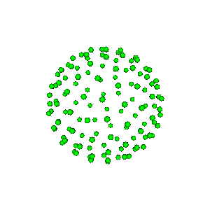
How high a b-value?
Increasing the b-value leads to:
Increased tissue contrast with areas of higher and lower diffusivity in principle
Decreased signal-to-noise ratio ⇒ Less reliable estimation of diffusion measures in practice
DTI: b ~ 1000 sec/mm²
DSI: b ~ 10,000 sec/mm²
Multi-shell: b ~ 1,000; 2,500; 5,000 sec/mm²
Data can be acquired at multiple b-values for trade-off (i.e. multi-shell acquisitions)
Repeat acquisition and average to increase signal-to-noise ratio

Slide 11
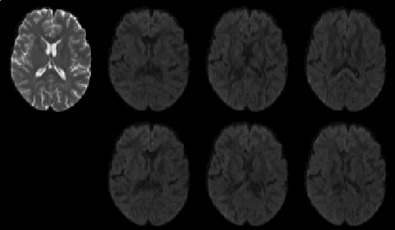
Looking at the data
A diffusion dataset consists of:
A set of non-diffusion-weighted a.k.a “low-b” reference images (b-value = 0)
A set of diffusion-weighted (DW) images acquired with different gradient directions d₁, d₂, and b-value >0.
bvec: Gradient directions are stored as an array of x, y, z coordinates (as many rows as there are directions)
bval: B-values are stored as a 1-d vector of gradient intensities
The diffusion-weighted images have lower intensity values
b=0
b₁, d₁
b₂, d₂
b₃, d₃
Baseline
(b0) image
Diffusion-weighted
images
b₄, d₄
b₅, d₅
b₆, d₆
Notes:
The simple answer is that T2 weighted imaging makes structures with lots of water appear bright and T1 weighted imaging makes water dark and structures containing fat comparatively bright.
Basic T1 weighted imaging is useful for assessing structures that are high in fat or structures that are near water filled structures, such as joints, that would otherwise be hard to see on T2 weighted imaging.
Basic T2 weighted imaging is useful for assessing water rich structures and also for looking for local inflammation - which results in a higher volume of water in the affected tissues and so they appear bright on this sequence.

Slide 12
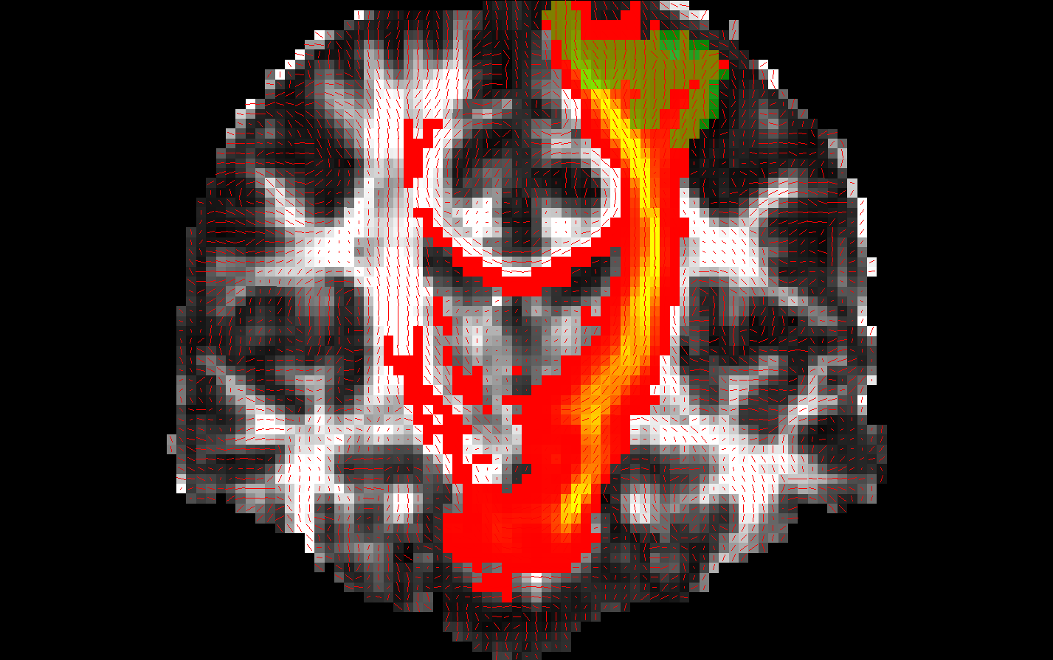
Data analysis steps
Pre-process images to reduce distortions
Fit a diffusion model at every voxel
Analysis of individual differences
Inter-subject analysis:
Compute measures of anisotropy/diffusivity and compare them between populations
Tract-Based Spatial Statistics (TBSS)
Intra-subject analysis:
Do tractography to reconstruct select pathways
Do tractography to reconstruct a structural connectome and study white matter microstructure as a network.

Slide 13
NDMG 2.0
A tool for efficiently generating high quality structural connectomes.
Intended to be scalable to large datasets.
Begin with raw NIFTI1 data (BIDS spec), end with graph(s)
Total runtime 20 min – 1 hour depending on runtime parameters
Allows for multiple spaces for performing tractography:
native-space, native-space with MNI-normalization, and MNI-space only
Allows for multiple forms of tractography:
Deterministic, probabilistic, particle (i.e. probabilistic with tissue priors)
Allows for multiple diffusion models:
CSA, CSD

Slide 14
Preprocessing
Notes:
Susceptibility artifact– some tissue in the brain has a greater tendency to become magnetized when placed in an external magnetic field.

Slide 15
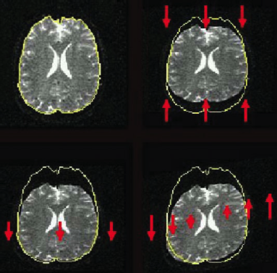
Distortions: Eddy currents
Cause: Fast switching of diffusion-encoding gradients induces eddy currents in conducting components
Eddy currents lead to residual gradients that shift the diffusion gradients
The shifts are direction-dependent, i.e., different for each DW image
Result: Geometric distortions
From Le Bihan et al., Artifacts and pitfalls in diffusion MRI, JMRI 2006
Notes:
Not the only form of preprocessing, but an essential one.

Slide 16
NDMG Preprocessing
Perform eddy correction on the dMRI series.
Reorient all input images to RAS+ and reslice to either 1mm or 2mm voxel resolution
Requires inversion to x, y, or z columns of bvecs depending on dimension of reorientation.
Reslicing to the same voxel scale enables dramatically faster registration
Create a mean B0 brain mask of all B0’s found in the dMRI series
Generate gradient table object based on bval/bvec info
Notes:
ALEX’s SLIDE

Slide 17
Registration

Slide 18
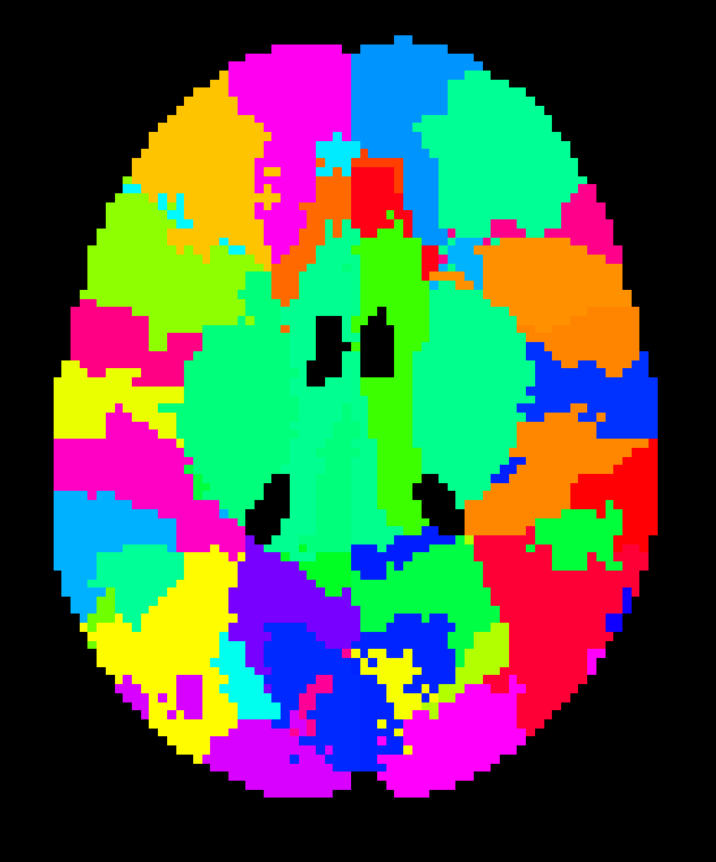
GOAL: Get atlas (what’s that?) to native diffusion space (what’s that?)
Notes:
ALEX’s SLIDE

Slide 19
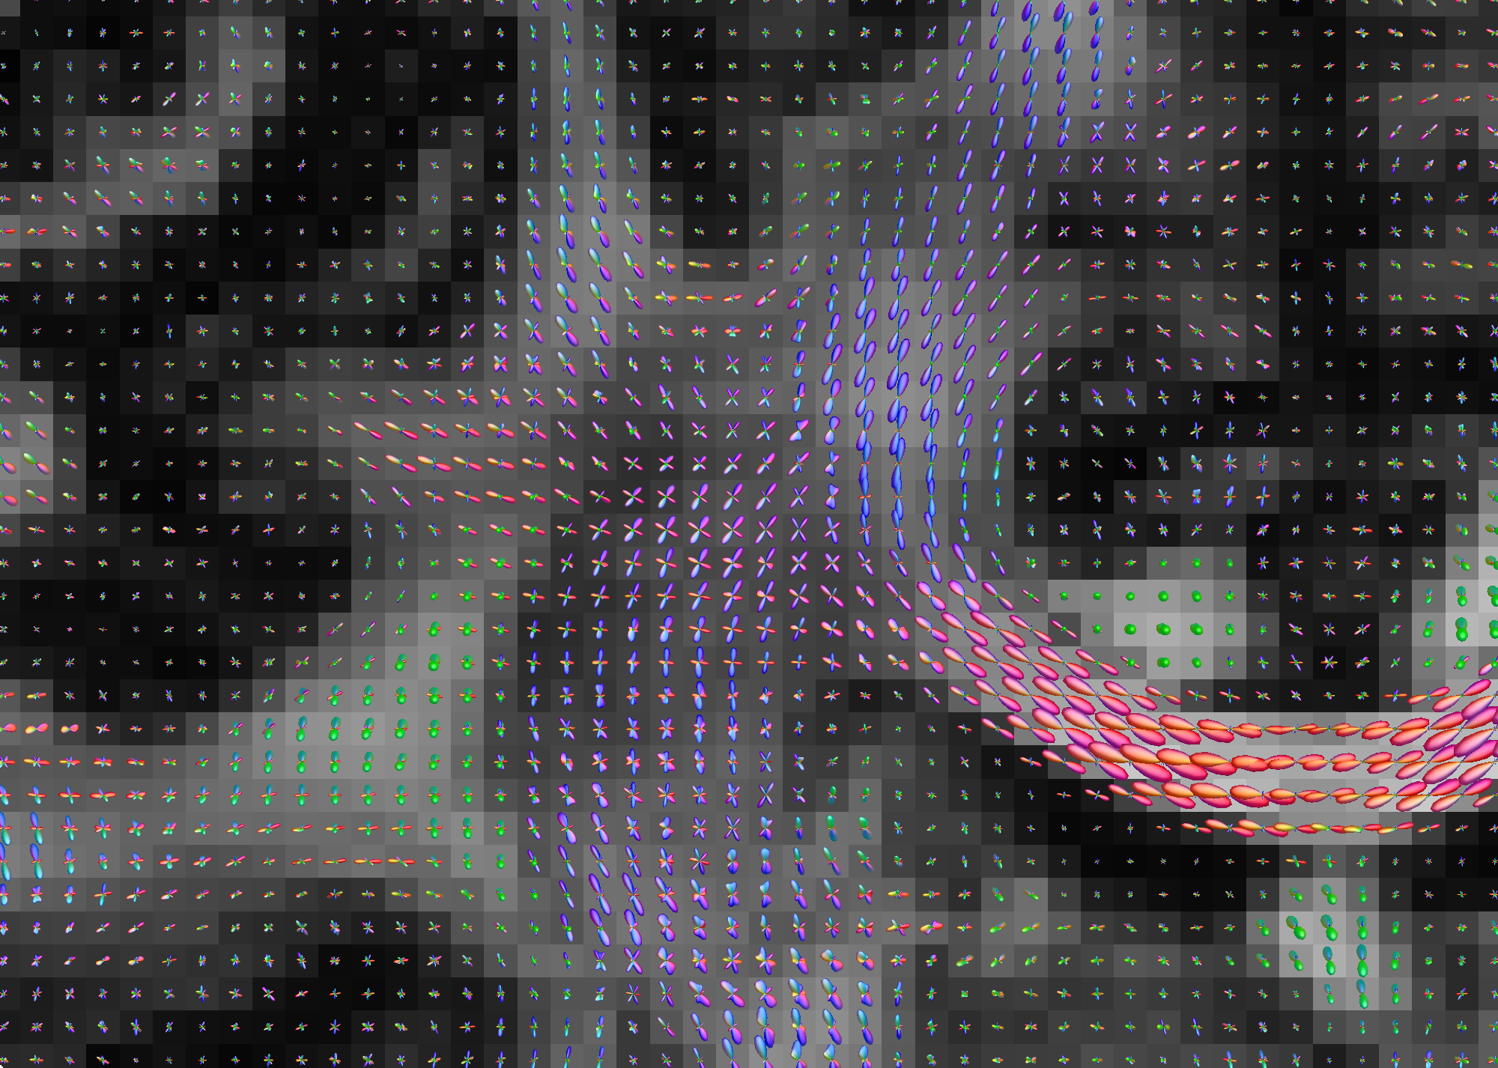
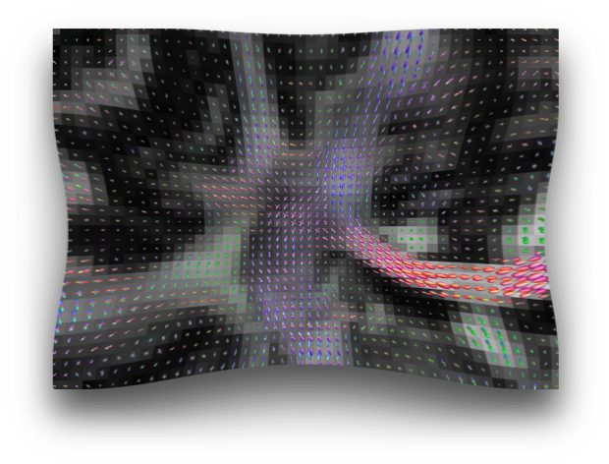
Subgoal: Minimize interpolation of dMRI
To perform tractography, we need to be able to coregister the dMRI series, T1/T2-weighted image, and atlas (containing brain regions/parcels) to one another.
This requires intermodal registrations, which presents a unique challenge for dMRI.
Non-rigid registration of dMRI to images from other modalities (T1w) causes stretching and shearing of anisotropic properties revealed by a diffusion model, potentially biasing the tractography (CITE).
If this was fMRI, the problem would be addressed by smoothing. In dMRI, we smoothing would bias the tractography, so we can’t use it.
Notes:
When reorientating fixels, one major undesirable effect is that the maxima in the native fixels no longer corresponds to the maxima in the reoriented fixels (Christiaens et al., 2012). This is because the reorientation introduces dimple artifacts hypothesized to be from the negative lobes in the Gibbs ringing. This directly affects subsequent deterministic and probabilistic fiber tractography performed in the template space, producing streamlines that do not match the original streamlines from native space. Moreover, streamline distributions generated from probabilistic tractography performed on reoriented fixels are deflected with respect to the native tract distribution (Christiaens et al., 2012). Although the latest work in FOD reorientation (FODR) using apodized point spread functions (PSFs) overcomes the dimple artifacts, slight distortions are still introduced into the spread of the fiber populations (Raffelt et al., 2012). On average the angular error between peak orientations is ∼8° (Raffelt et al., 2012). The error in peak orientation accumulates into large errors when performing tractography after normalization (Colon-Perez et al., 2015). Moreover, an obvious drawback of these types of solutions is that they depend specifically on the diffusion sampling and reconstruction method used and do not generalize easily to other diffusion methods.
Given the problems that arise from spatially normalizing diffusion information prior to streamline construction, we sought to determine if direct streamline normalization (DSN), where the streamlines are created first, in the same space as the diffusion scans, followed by the warping of these streamlines into the template space would yield more precise results. In this case, the deformation fields from the normalization of each subject to the template are used for warping the streamlines (Hua et al., 2008; Thottakara et al., 2006). DSN confers multiple potential advantages. DWIs can be acquired with any desired sampling scheme. Diffusion tensors, FODs, or ODFs can also be reconstructed using any desired method and streamlines generated using any algorithm. Most importantly, it avoids the problem of generating streamlines from reoriented diffusion tensors, FODs, or ODFs that are distorted relative to their native counterparts, which substantially reduces errors in tract morphology relative to the subject’s native structure.

Slide 20
NDMG registration
Previous version of NDMG: Perform non-linear registration to conform the dMRI series to the T1w image conformed to MNI template space.
Advantages: Quick-and-dirty, provides morphological normalization
Disadvantages: Treats dMRI like fMRI and adds interpolation that can bias the tractography
New version of NDMG:
“Works around” the interpolation problem through a sequence of non-linear and linear registrations of the other images.
Facilitates ‘native-space’ tractography, but requires post-hoc normalization methods.
Notes:
When reorientating fixels, one major undesirable effect is that the maxima in the native fixels no longer corresponds to the maxima in the reoriented fixels (Christiaens et al., 2012). This is because the reorientation introduces dimple artifacts hypothesized to be from the negative lobes in the Gibbs ringing. This directly affects subsequent deterministic and probabilistic fiber tractography performed in the template space, producing streamlines that do not match the original streamlines from native space. Moreover, streamline distributions generated from probabilistic tractography performed on reoriented fixels are deflected with respect to the native tract distribution (Christiaens et al., 2012). Although the latest work in FOD reorientation (FODR) using apodized point spread functions (PSFs) overcomes the dimple artifacts, slight distortions are still introduced into the spread of the fiber populations (Raffelt et al., 2012). On average the angular error between peak orientations is ∼8° (Raffelt et al., 2012). The error in peak orientation accumulates into large errors when performing tractography after normalization (Colon-Perez et al., 2015). Moreover, an obvious drawback of these types of solutions is that they depend specifically on the diffusion sampling and reconstruction method used and do not generalize easily to other diffusion methods.
Given the problems that arise from spatially normalizing diffusion information prior to streamline construction, we sought to determine if direct streamline normalization (DSN), where the streamlines are created first, in the same space as the diffusion scans, followed by the warping of these streamlines into the template space would yield more precise results. In this case, the deformation fields from the normalization of each subject to the template are used for warping the streamlines (Hua et al., 2008; Thottakara et al., 2006). DSN confers multiple potential advantages. DWIs can be acquired with any desired sampling scheme. Diffusion tensors, FODs, or ODFs can also be reconstructed using any desired method and streamlines generated using any algorithm. Most importantly, it avoids the problem of generating streamlines from reoriented diffusion tensors, FODs, or ODFs that are distorted relative to their native counterparts, which substantially reduces errors in tract morphology relative to the subject’s native structure.

Slide 21
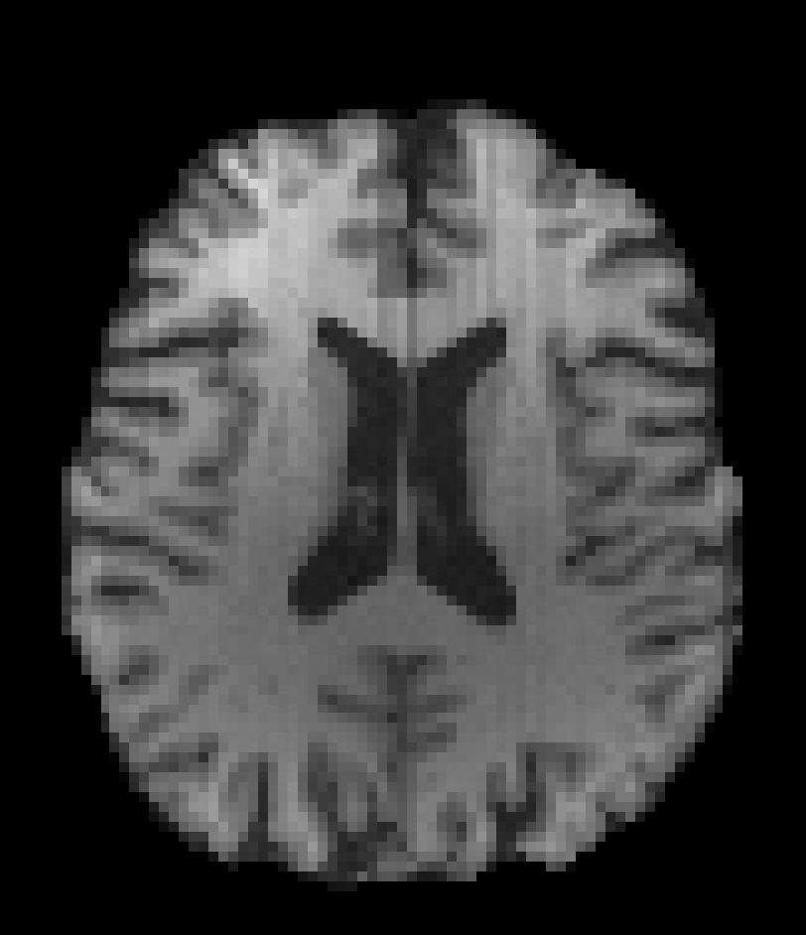
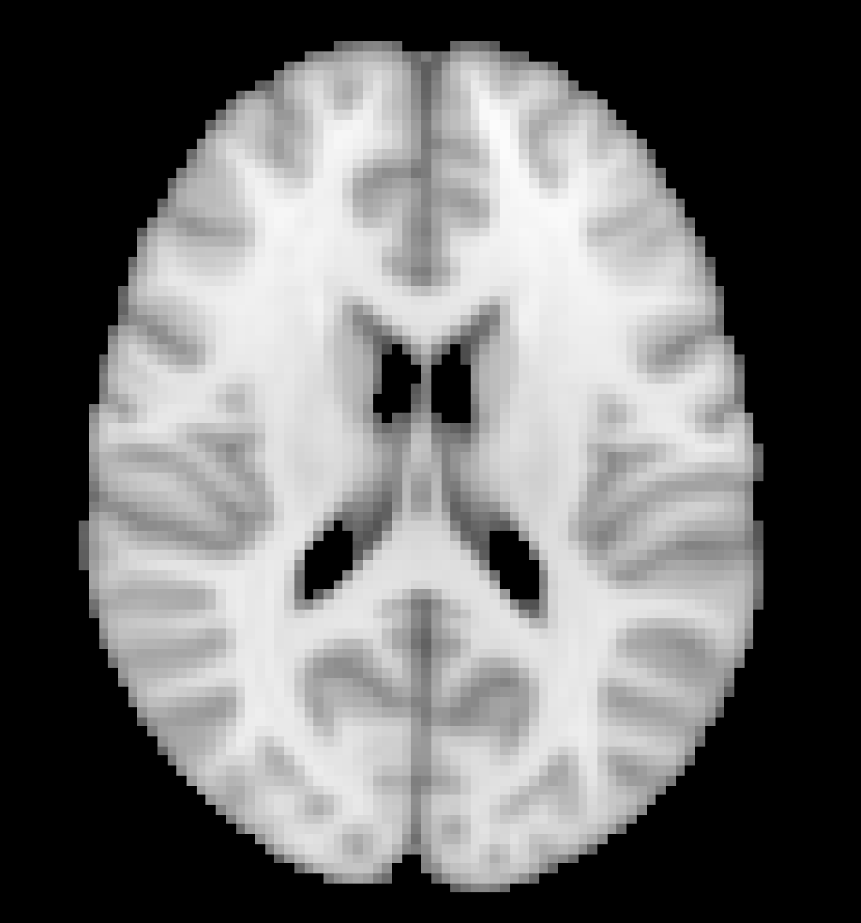
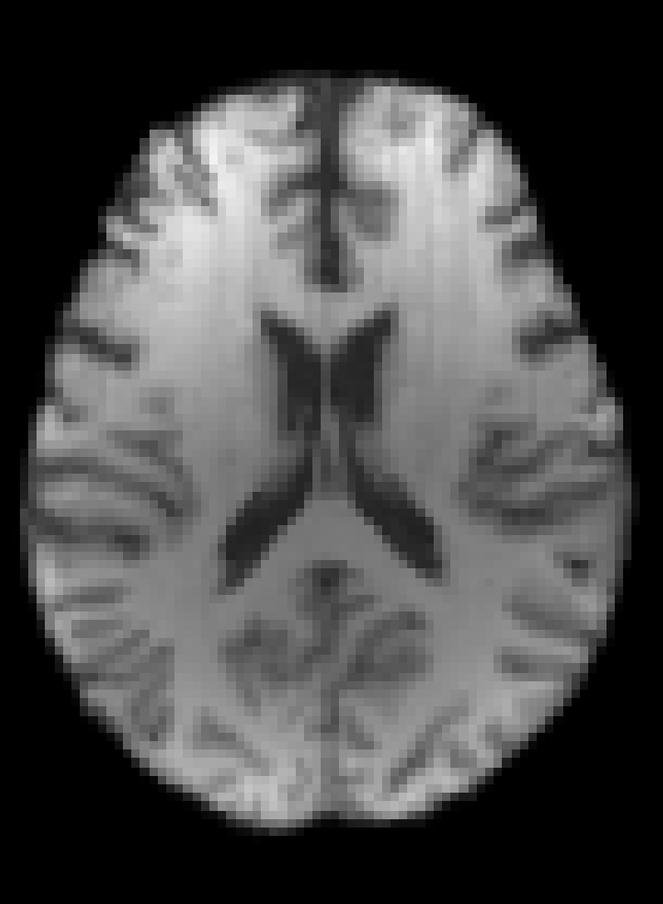
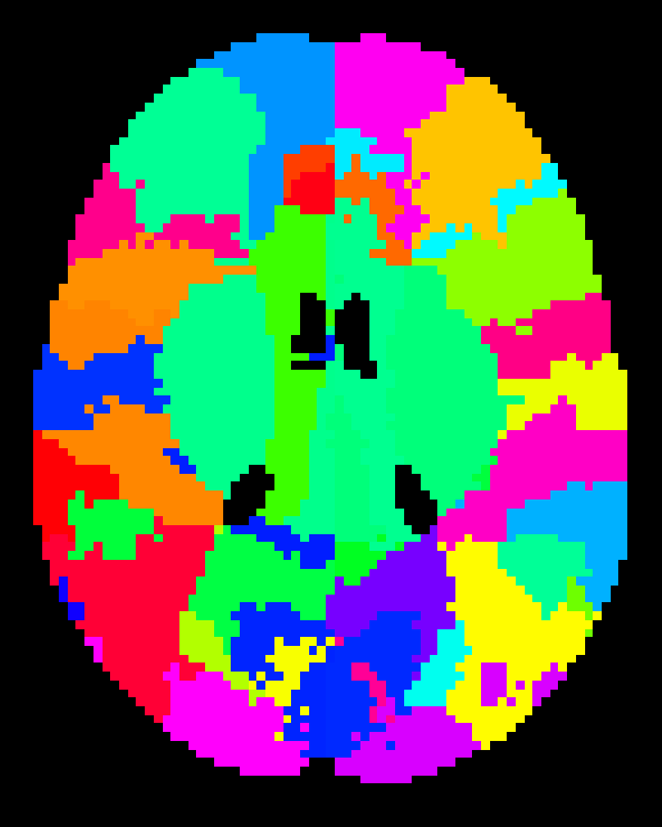
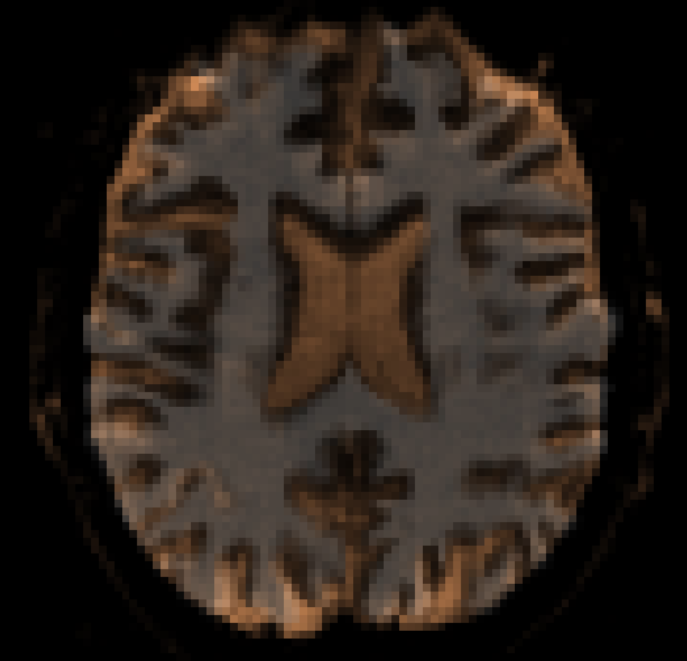
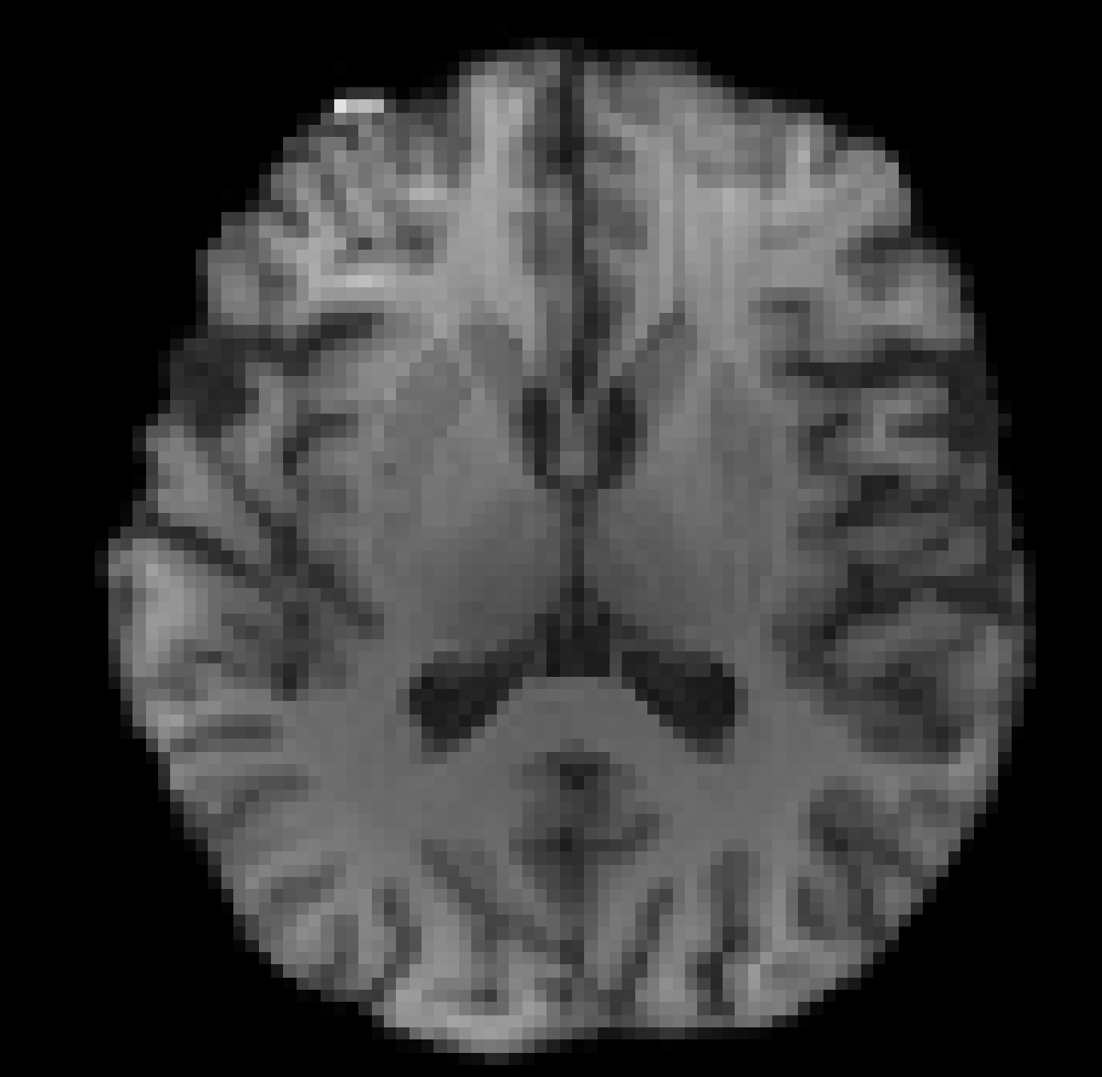
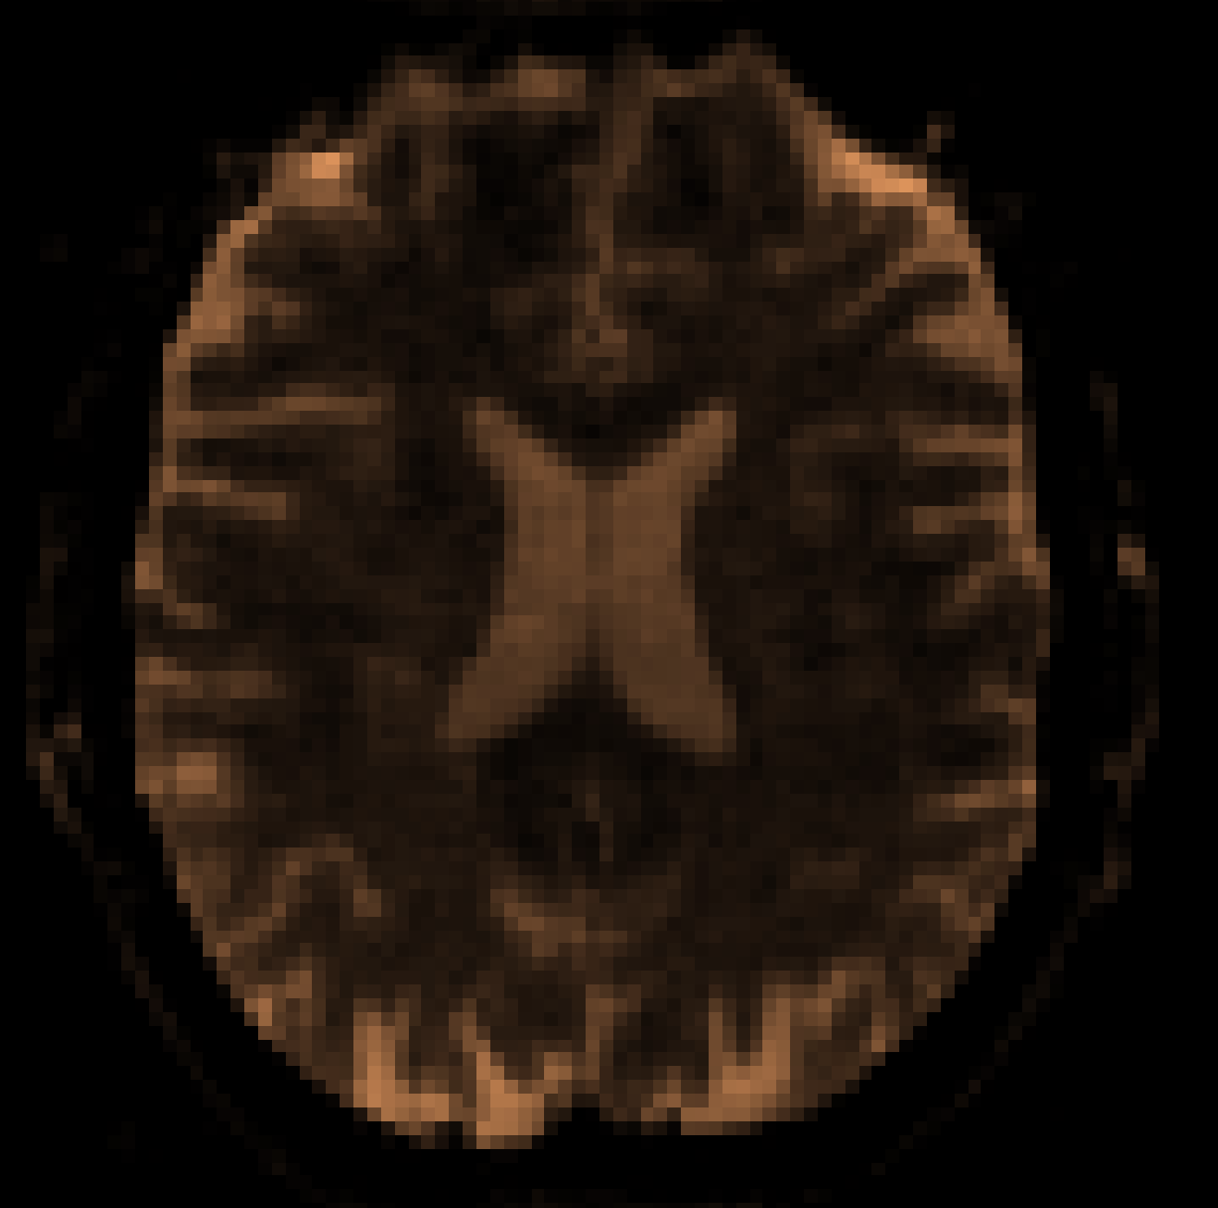
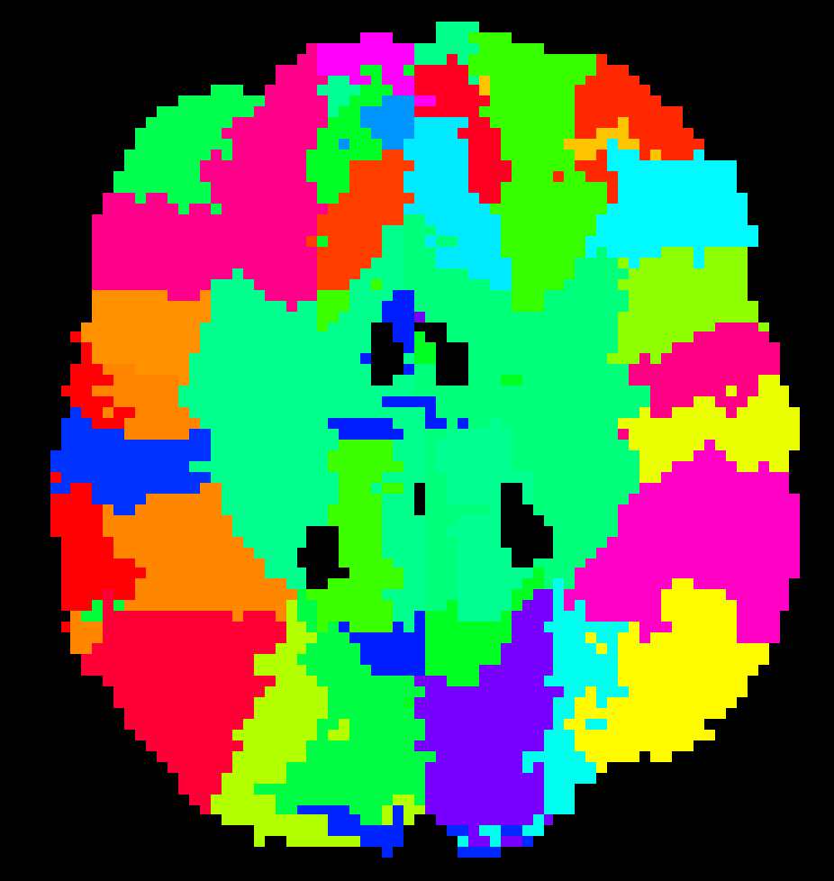
NDMG registration pipeline
T1w → MNI (non-linear)
Atlas → MNI-T1w conformed atlas (non-linear)
T1w → native dwi (linear with ‘boundary-based’ tissue priors from T1w white-matter segmentation)
MNI-T1w conformed atlas → T1w (inverse of non-linear warp from (1)) → native dwi (transform from (3))
Notes:
When reorientating fixels, one major undesirable effect is that the maxima in the native fixels no longer corresponds to the maxima in the reoriented fixels (Christiaens et al., 2012). This is because the reorientation introduces dimple artifacts hypothesized to be from the negative lobes in the Gibbs ringing. This directly affects subsequent deterministic and probabilistic fiber tractography performed in the template space, producing streamlines that do not match the original streamlines from native space. Moreover, streamline distributions generated from probabilistic tractography performed on reoriented fixels are deflected with respect to the native tract distribution (Christiaens et al., 2012). Although the latest work in FOD reorientation (FODR) using apodized point spread functions (PSFs) overcomes the dimple artifacts, slight distortions are still introduced into the spread of the fiber populations (Raffelt et al., 2012). On average the angular error between peak orientations is ∼8° (Raffelt et al., 2012). The error in peak orientation accumulates into large errors when performing tractography after normalization (Colon-Perez et al., 2015). Moreover, an obvious drawback of these types of solutions is that they depend specifically on the diffusion sampling and reconstruction method used and do not generalize easily to other diffusion methods.
Given the problems that arise from spatially normalizing diffusion information prior to streamline construction, we sought to determine if direct streamline normalization (DSN), where the streamlines are created first, in the same space as the diffusion scans, followed by the warping of these streamlines into the template space would yield more precise results. In this case, the deformation fields from the normalization of each subject to the template are used for warping the streamlines (Hua et al., 2008; Thottakara et al., 2006). DSN confers multiple potential advantages. DWIs can be acquired with any desired sampling scheme. Diffusion tensors, FODs, or ODFs can also be reconstructed using any desired method and streamlines generated using any algorithm. Most importantly, it avoids the problem of generating streamlines from reoriented diffusion tensors, FODs, or ODFs that are distorted relative to their native counterparts, which substantially reduces errors in tract morphology relative to the subject’s native structure.

Slide 22
Model-fitting (i.e. ‘reconstruction’)

Slide 23
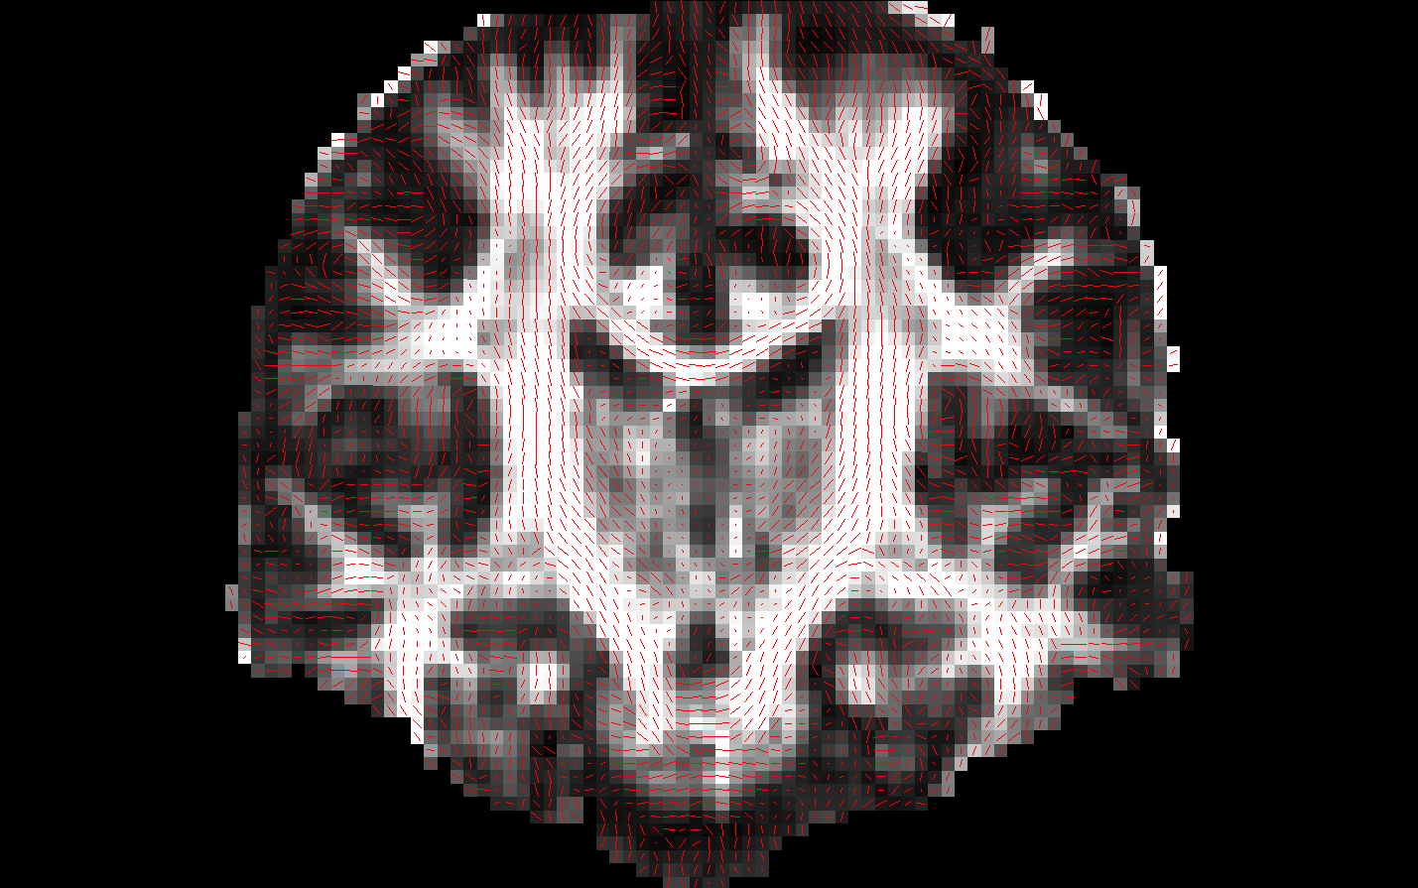
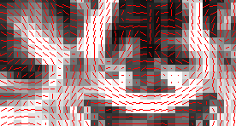
How to represent diffusion
At every voxel we want to know:
Is this in white matter?
If yes, what pathway(s) is it part of?
What is the orientation of diffusion?
What is the magnitude of diffusion?
A standard T1-weighted image cannot capture all this!

Slide 24
Fitting an orientation model to diffusion data

Slide 25
Simplest model: Tensor
A tensor is a 3x3 symmetric, positive-definite matrix:
Eigenvectors express diffusion direction
Eigenvalues express diffusion magnitude
d₁₁ d₁₂ d₁₃
d₁₂ d₂₂ d₂₃
d₁₃ d₂₃ d₃₃
D =
Isotropic diffusion:
λ₁ ≈ λ₂ ≈ λ₃
Anisotropic diffusion:
λ₁ >> λ₂ ≈ λ₃
λ₁ e₁
λ₁ e₁
λ₂ e₂
λ₂ e₂
λ₃ e₃
λ₃ e₃
One such ellipsoid at each voxel: Likelihood of water molecule displacements at that voxel
Notes:
Linear project based on an orientation distribution function

Slide 26
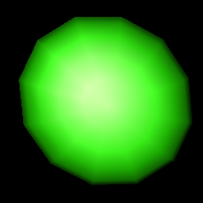
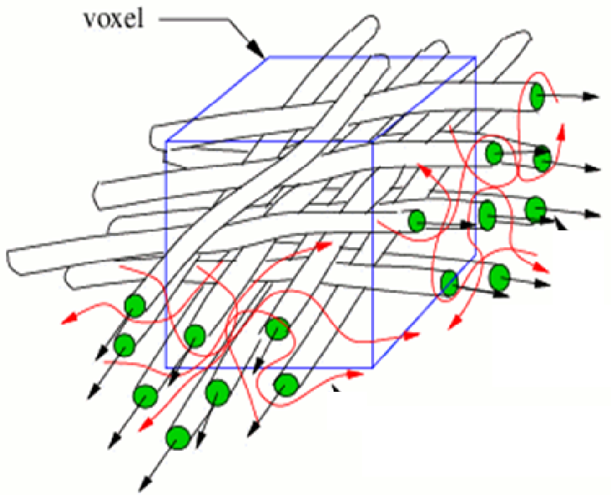
Limits of the Diffusion Tensor Model
Fiber Crossing
Fiber orientations
Tensor
We estimate that 2/3 of voxels have more than one fiber population!

Slide 27
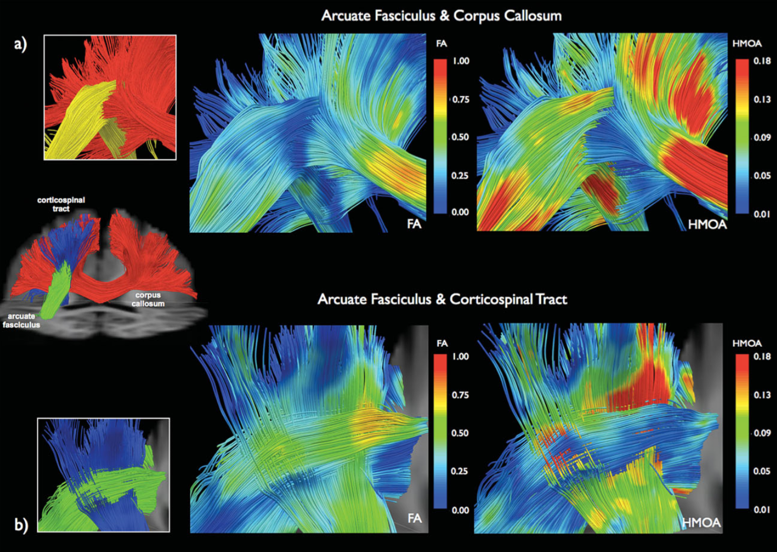

Slide 28
Notes:
The spherical harmonics are a complete set of orthogonal functions on the sphere, and thus may be used to represent functions defined on the surface of a sphere, just as circular functions (sines and cosines) are used to represent functions on a circle via Fourier series.

Slide 29
The many models of diffusion
Variable number of fiber populations: Probability distribution of fiber populations at different diffusion orientations and magnitude (FOD, diffusion spectrum)
Orientation distribution function (ODF): Probability distribution of spin diffusion (orientation only)
Fixed number of fiber populations: Diffusion orientation and magnitude for N compartments (mixture of tensors, ball-and-stick, etc.)
Tensor: Single diffusion orientation and magnitude
Notes:
Many ODF probability density functions rely on linear radial projection, which neglects the change in the volume element along each direction

Slide 30
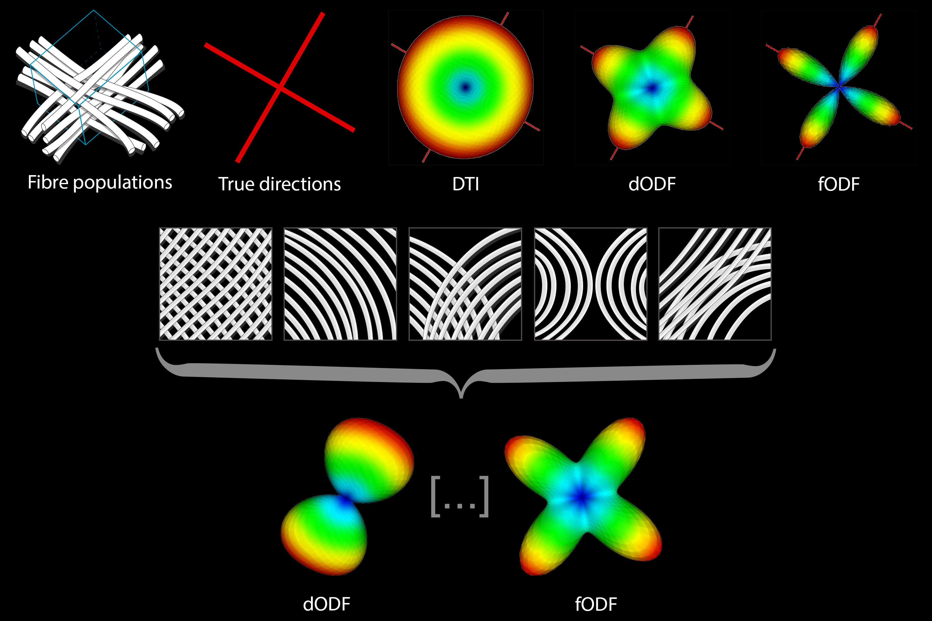
Notes:
the tensor model is insensitive to the complex fiber architectures found in the vast majority of voxels in the human brain.
The inability to resolve intra-voxel fiber orientations may have important implications for the utility of standard DTI-based tract reconstruction methods.
Intra-voxel fiber orientations can now be identified using novel, tensor-free approaches.

Slide 31
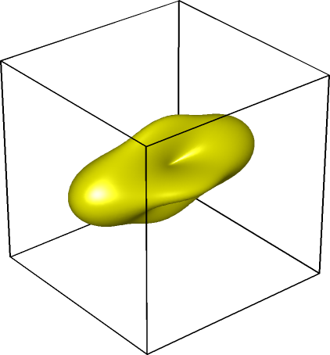
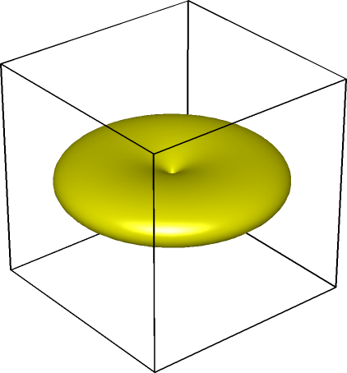
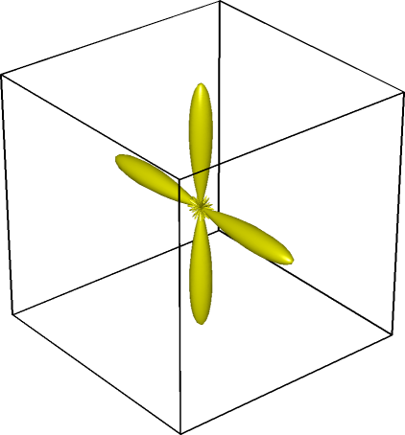
Fiber Orientation Distribution function (FOD)
Constrained Spherical Deconvolution (CSD) (Tournier et al., 2004)
⊗
=
-1
DW-MRI Signal
Single fiber Signal (Response)
Fiber distribution
Notes:
The FOD can be then obtained by the inverse operation, i.e. the spherical deconvolution of the diffusion weighted signal by the response function.
Deconvolution: a process of resolving something into its constituent elements or removing complication in order to clarify it.
spherical harmonics are special functions defined on the surface of a sphere.

Slide 32
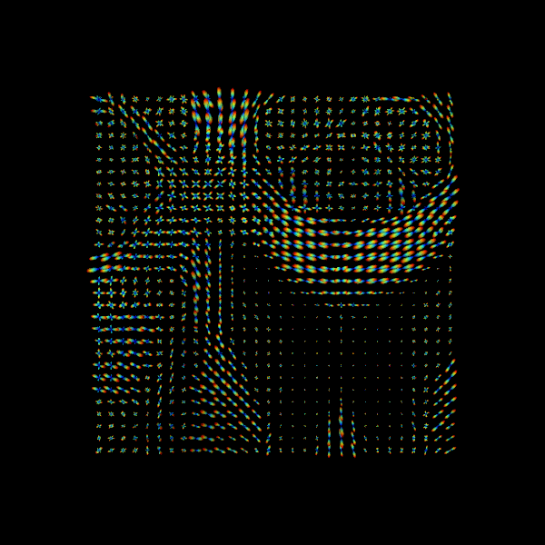
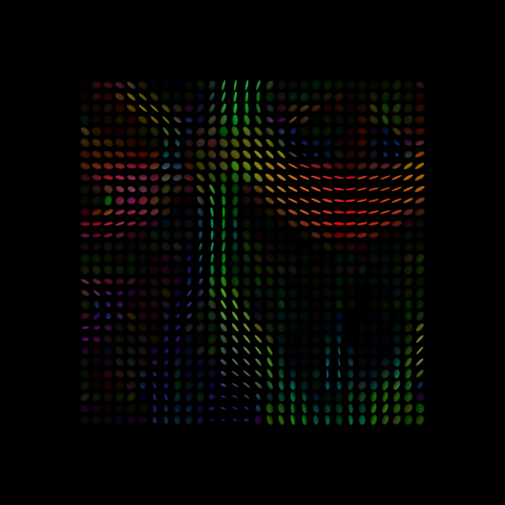
Fiber Orientation Distribution Function
CSD
DTI

Slide 34
NDMG model-fitting
Multiple options available (one ODF and one FOD):
Constant Solid Angle ODF (CSA)
One of the simplest, yet most robust ODF estimates.
Dimensionless and intrinsically normalized since the integrals of the first and second terms over the sphere are, respectively, 1 and 0.
Works for single and multi-shell data.
Constrained Spherical Deconvolution FOD (CSD)
Estimate the response function of a single fiber then we could deconvolve the measured signal and obtain the underlying fiber distribution.
Superior to CSA, but computationally more expensive.
Currently only implemented for single-shell data.

Slide 35
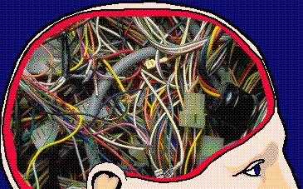
Tractography

Slide 36
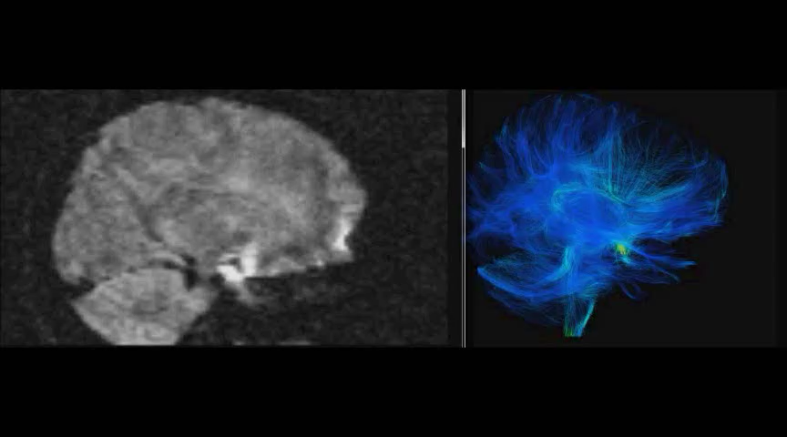
Single Subject Diffusion Weighted MRI
Single Subject White Matter Reconstruction

Slide 37
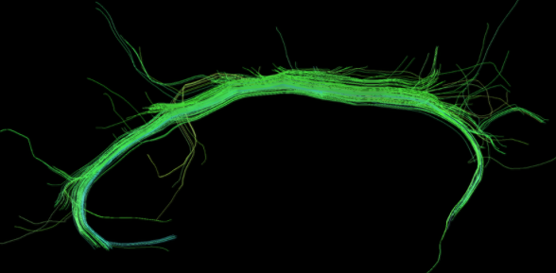
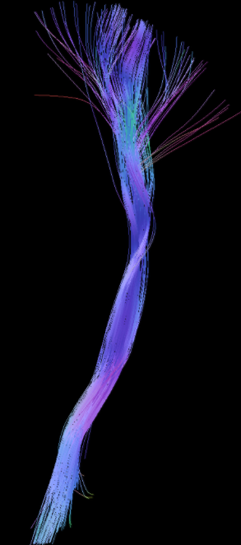
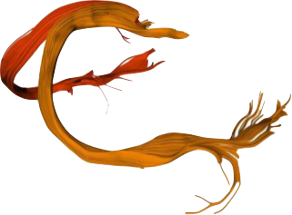
Historically, tractography was not intended for connectomics!
Neurosurgical planning
(e.g. tumor removal)
Exploring Individual differences in microstructure of known fascicles/ bundles of white-matter

Slide 38
Requirements for streamline tractography
3D Images of the white matter orientation e.g. tensors, ODFs, fiber ODFs, peaks
Direction selection strategy - DirectionGetters e.g. highest value, probabilistic approaches
Tracking Mask - TissueClassifier e.g. white matter volume -> estimated from the anatomical Image or DWI
Seeding Mask e.g. region of interest, wm-gm interface, white matter volume
Tracking Parameters:
Step size and interpolation method e.g. nearest neighbour, tri-linear
Stopping Criteria e.g. maximum curvature (deviation angle), mask

Slide 39
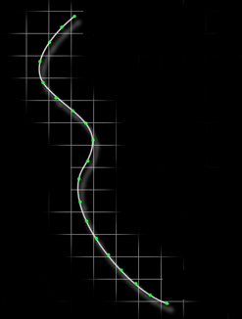
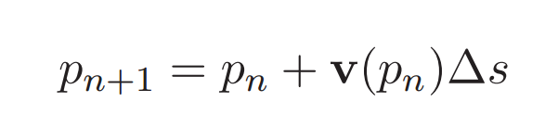
How are streamlines constructed?
Streamlines are polylines locally aligned with white matter orientations (i.e. as determined by the diffusion model fit to the data beforehand)
The streamline reached a stopping criteria at P₁₈ (e.g. TissueClassifier)
We need to interpolate for v(P_{n}) (e.g. nearest neighbour, tri-linear)
P₀: (x₀,y₀,z₀) (seed)
Δs
v(p₆) (directionGetter)
pn := n^{th} point of the streamline
v(pn) := direction vector at pn
Δs := step size
P₉: (x₉,y₉,z₉)
P₁₈: (x₁₈,y₁₈,z₁₈)
Notes:
In computer graphics, a polyline is a continuous line composed of one or more line segments. You can create a polyline by specifying the endpoints of each segment. In draw programs, you can treat a polyline as a single object, or divide it into its component segments.

Slide 40
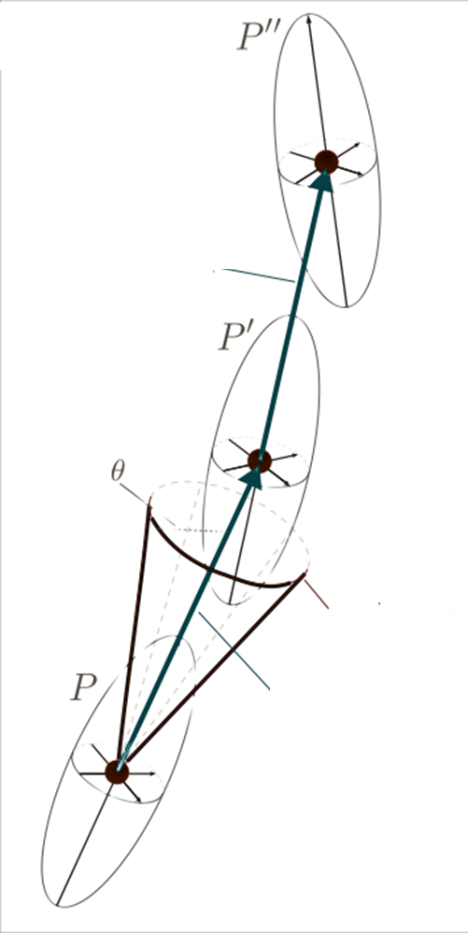
Tracking (in the tensor case)
For each seed position (initial position)
Follow the eigenvector associated with principal eigenvalue
Stop if:
The position p_{n} is outside of the mask
The angle between the vector v_{n} and v_{n-1} is greater than the fixed maximum (e.g. opening angle θ=60º)
Restart from the seed in the opposite initial direction
Principal Direction
Maximum Angle
P₀
Δs

Slide 41
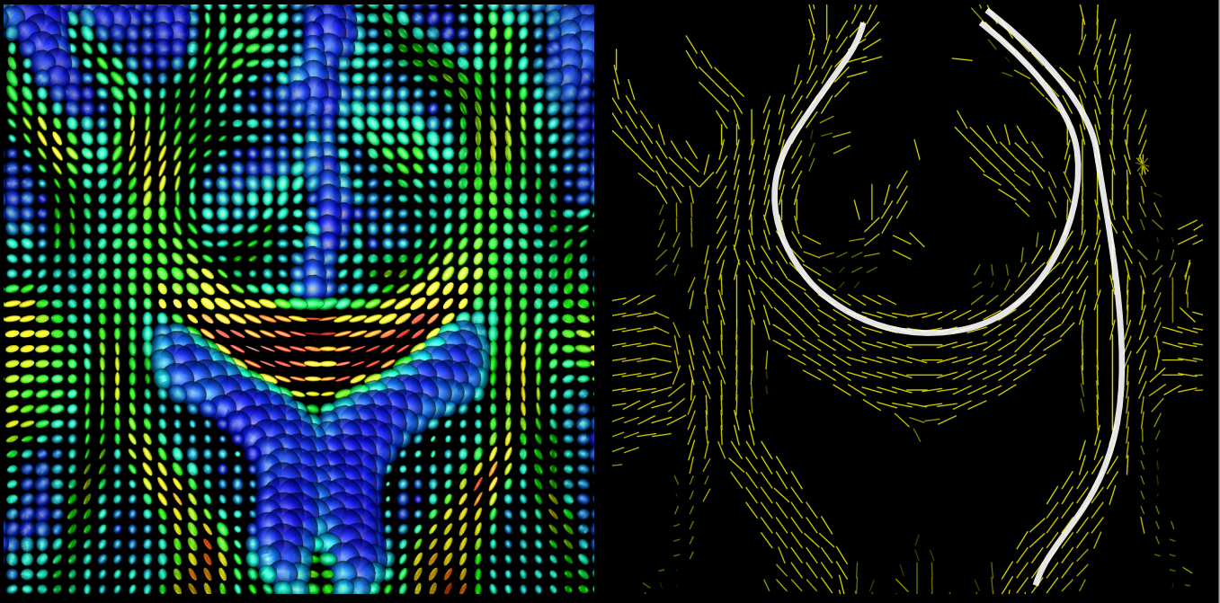

Slide 42
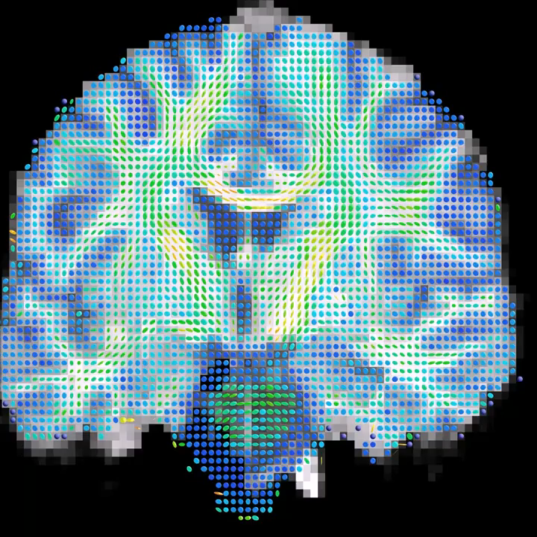
Principal Direction
Maximum Angle
Δs

Slide 43
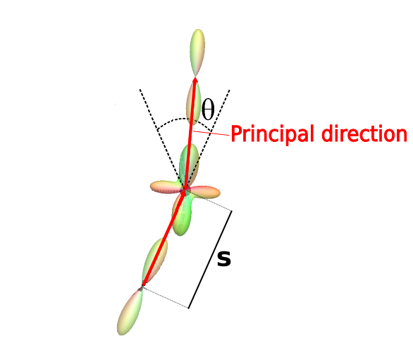
Deterministic Fiber ODF Tractography
Follow the maximum of the fiber ODF
If multiple peaks are available, follow the closest to the incoming direction
Peak / Maximum
ΔS
ΔS : step size
θ : opening angle

Slide 44
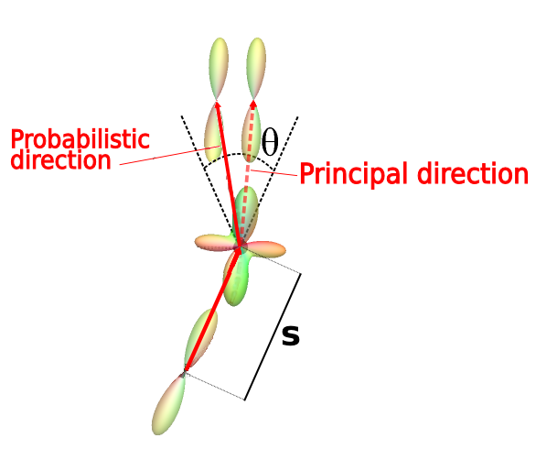
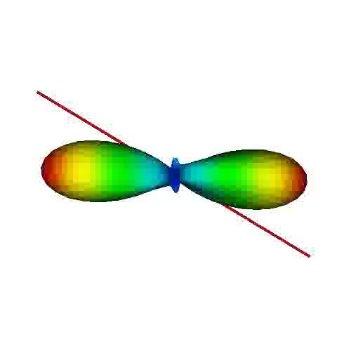
Probabilistic Fiber ODF Tractography
Sample the fiber ODF to select a direction to follow
Peak / Maximum
ΔS
ΔS : step size
θ : opening angle

Slide 45
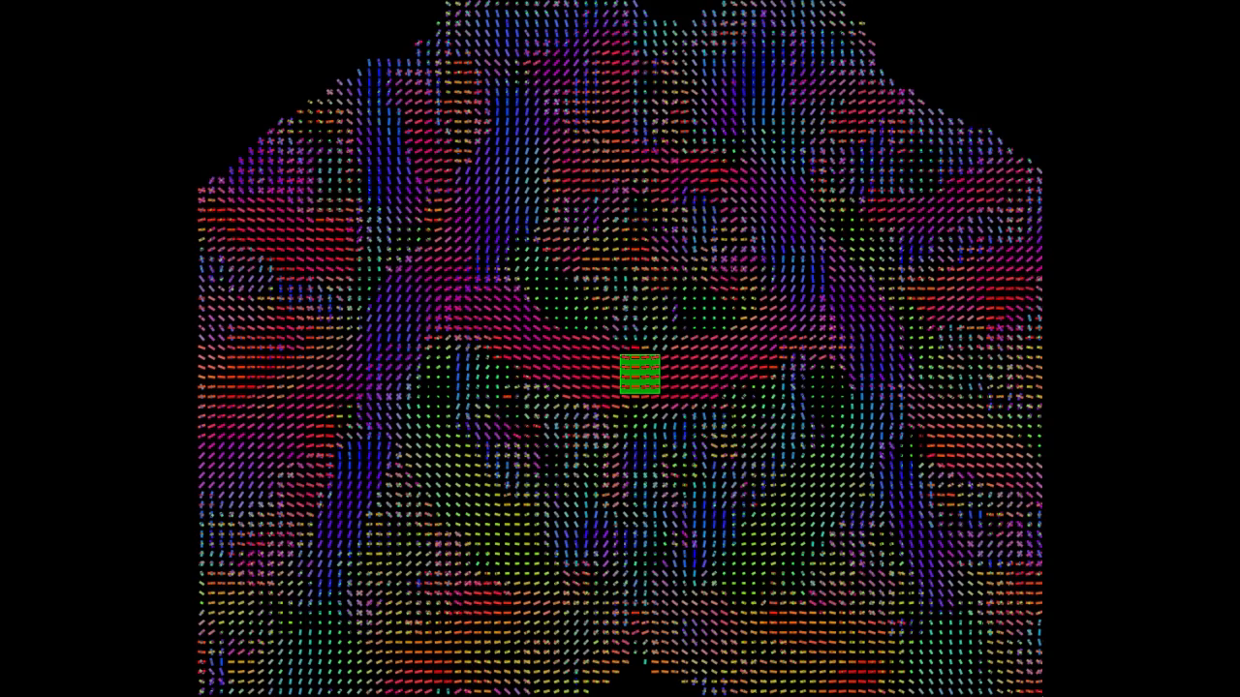




Fiber ODF Tractography

Slide 46

NDMG Tractography
Offers probabilistic, deterministic, and particle tracking methods.
Denser seeding (configurable with --seed flag) yields more streamlines.
500,000 -1 million streamlines are recommended (--seed 20/25) as the absolute lower limit for excellent reproducibility.
Reproducibility continues to increase further with increasing number of streamlines.
…But runtime increases exponentially as a function of seeding density!
Seeding occurs through GM-WM interface as well as throughout Corpus Callosum.
Notes:
Particle filtering is probabilistic tractography that offers a way to approximate a probability distribution over all paths originated from a specified voxel, given the diffusion information.
Goal: have a tractography that stops in grey matter and avoids CSF.
Here’s how it works:
Particle Filtering Tractography (PFT) [Girard2014] uses tissue partial volume estimation (PVE) to reconstruct trajectories connecting the gray matter, and not incorrectly stopping in the white matter or in the corticospinal fluid. It relies on a tissue classifier that identifies the tissue where the streamline stopped. If the streamline correctly stopped in the gray matter, the trajectory is kept. If the streamline incorrecly stopped in the white matter or in the corticospinal fluid, PFT uses anatomical information to find an alternative streamline segment to extend the trajectory. When this segment is found, the tractography continues until the streamline correctly stops in the gray matter.

Slide 47

Structural connectivity analysis
Nodes = Grey matter regions of interest (from an atlas) containing streamline endpoints
Edges = Properties of white matter revealed by tractography streamlines (i.e. their number and integrity)

Slide 48

Two primary approaches to estimation
1) Post-hoc method: Generate a whole brain ‘tractogram’ first, then estimate connectivity based on number/properties of streamlines passing through each atlas region.
Good for quick and dirty estimation.
Less computationally expensive
Limited seeding densities possible since seeding typically occurs throughout the entirety of white matter.
2) ROI-ROI seeding method: Seed only from the atlas regions→ produces a tractogram consisting of only those streamlines connecting an atlas region to at least one other.
Better use of probabilistic tractography.
Enables ‘denser’ seeding from relevant atlas regions.
More computationally expensive

Slide 49


How we define Nodes (Surfaces vs. Volumes)
Streamlines points intersecting with surfaces
Streamline points intersecting with volumes

Slide 50
NDMG graph generation
How do we define connectivity (i.e. edges and their weights) of structural connectomes?
Fiber count? Fractional anisotropy (i.e. microstructural ‘integrity’)? Some combination of these? Other measures? Currently an open question in neuroscience.
In NDMG, we define connectivity as fiber-count because:
It’s the gold-standard in the field and FA can be confounded by the impact of crossing fibers.
If a fiber passes through an atlas region, count it as a valid connection.
Resulting graph is a summary of fiber counts for a given atlas.
Notes:
When reorientating fixels, one major undesirable effect is that the maxima in the native fixels no longer corresponds to the maxima in the reoriented fixels (Christiaens et al., 2012). This is because the reorientation introduces dimple artifacts hypothesized to be from the negative lobes in the Gibbs ringing. This directly affects subsequent deterministic and probabilistic fiber tractography performed in the template space, producing streamlines that do not match the original streamlines from native space. Moreover, streamline distributions generated from probabilistic tractography performed on reoriented fixels are deflected with respect to the native tract distribution (Christiaens et al., 2012). Although the latest work in FOD reorientation (FODR) using apodized point spread functions (PSFs) overcomes the dimple artifacts, slight distortions are still introduced into the spread of the fiber populations (Raffelt et al., 2012). On average the angular error between peak orientations is ∼8° (Raffelt et al., 2012). The error in peak orientation accumulates into large errors when performing tractography after normalization (Colon-Perez et al., 2015). Moreover, an obvious drawback of these types of solutions is that they depend specifically on the diffusion sampling and reconstruction method used and do not generalize easily to other diffusion methods.
Given the problems that arise from spatially normalizing diffusion information prior to streamline construction, we sought to determine if direct streamline normalization (DSN), where the streamlines are created first, in the same space as the diffusion scans, followed by the warping of these streamlines into the template space would yield more precise results. In this case, the deformation fields from the normalization of each subject to the template are used for warping the streamlines (Hua et al., 2008; Thottakara et al., 2006). DSN confers multiple potential advantages. DWIs can be acquired with any desired sampling scheme. Diffusion tensors, FODs, or ODFs can also be reconstructed using any desired method and streamlines generated using any algorithm. Most importantly, it avoids the problem of generating streamlines from reoriented diffusion tensors, FODs, or ODFs that are distorted relative to their native counterparts, which substantially reduces errors in tract morphology relative to the subject’s native structure.

Slide 51


Key Issues: Sensitivity Recovering “true” fiber connections
With sufficient number of streamlines (i.e. >500,000), most algorithms are able to produce tractograms containing 90% of the ground truth bundles (Maier-Hein et al., 2017)
Challenge (a): Resolve crossing-fibers
Probabilistic with local or particle tractography lead to greatest improvement in sensitivity.
Notes:
Maier-Hein study created a simulated human brain data set with ground truth tracts
Ex vivo imaging and tracing^{17,18,19,20,21,22,23} or physically^{24,25,26,27,28,29,30} and numerically simulated phantoms^{31,32,33,34} allow validation to some extent, and in specific circumstances such as basic fiber configurations. The nervous system, however, is complex and precise ground truth information on the trajectories of pathways and their origins, as well as terminations in the human brain is lacking. This makes it hard to obtain quantitative and comprehensive reliability estimations of tractography and to determine which discoveries are reliable when regarding brain connectivity in health and disease.

Slide 52


Key Issues: Sensitivity Recovering “true” fiber connections
Challenge (b): Recovering not just ipsilateral, but also contralateral connections.
Long commissural (interhemispheric) fibers need to be tracked.
Larger step-sizes in tractography can help.
Denser seeding from Corpus Callosum can also help, so in NDMG we do this.
Notes:
Maier-Hein study created a simulated human brain data set with ground truth tracts
Ex vivo imaging and tracing^{17,18,19,20,21,22,23} or physically^{24,25,26,27,28,29,30} and numerically simulated phantoms^{31,32,33,34} allow validation to some extent, and in specific circumstances such as basic fiber configurations. The nervous system, however, is complex and precise ground truth information on the trajectories of pathways and their origins, as well as terminations in the human brain is lacking. This makes it hard to obtain quantitative and comprehensive reliability estimations of tractography and to determine which discoveries are reliable when regarding brain connectivity in health and disease.

Slide 53

Key Issues: Sensitivity Recovering “true” fiber connections
Challenge (c): Sufficiently liberal criteria for classifying a fiber as a ‘connection.’
Must volumetrically pass through the voxels of an atlas label (i.e. node).
Problems to consider: Should only 1 voxel of streamline-label overlap constitute a true connection? What about a set of streamline points that are 1 voxel away from a label?
May have a ground-truth connection that never gets counted with discrete counting routines.
Notes:
Maier-Hein study created a simulated human brain data set with ground truth tracts
Ex vivo imaging and tracing^{17,18,19,20,21,22,23} or physically^{24,25,26,27,28,29,30} and numerically simulated phantoms^{31,32,33,34} allow validation to some extent, and in specific circumstances such as basic fiber configurations. The nervous system, however, is complex and precise ground truth information on the trajectories of pathways and their origins, as well as terminations in the human brain is lacking. This makes it hard to obtain quantitative and comprehensive reliability estimations of tractography and to determine which discoveries are reliable when regarding brain connectivity in health and disease.
One solution: consider a ‘Euclidian neighborhood’ of a volume-based parcel (e.g. by dilating the parcel) may perform even better at less cost.

Slide 54
Key Issues: Specificity Reducing false-positive/negative connections
4x more invalid than valid connections from tractography!
Results do not improve with higher-direction data or using more sophisticated models (CSD)
Solution (a): Use underlying tissue information (WM, GM, CSF boundaries)
Avoid ventricular CSF (because we know that WM fibers do not pass through this region)
Only track within tissue that has >0.05 probability of being in WM.
Solution (b): streamline filtering (Malcolm et al., 2010)
By fiber length (>10-60mm and <150-200mm)
May reduce false positves by as much as 80-90%!
Notes:
Maier-Hein study created a simulated human brain data set with ground truth tracts
Ex vivo imaging and tracing^{17,18,19,20,21,22,23} or physically^{24,25,26,27,28,29,30} and numerically simulated phantoms^{31,32,33,34} allow validation to some extent, and in specific circumstances such as basic fiber configurations. The nervous system, however, is complex and precise ground truth information on the trajectories of pathways and their origins, as well as terminations in the human brain is lacking. This makes it hard to obtain quantitative and comprehensive reliability estimations of tractography and to determine which discoveries are reliable when regarding brain connectivity in health and disease.

Slide 55



NDMG 2.0 normalization
How might we normalize structural connectomes so that we don’t bias the tractography through morphological interpolation?
Option 1) Graph normalization post-tractography: Apply Pass-to-Ranks to the graph (discriminability increases by >10% following native-space tractography)
Option 2) Morphological normalization: Apply Direct-Streamline Normalization (DSN) to the tractogram
Use a rigid affine transformation (from dwi to MNI) to map streamline coordinates directly back to MNI-space
Template
FA
Notes:
When reorientating fixels, one major undesirable effect is that the maxima in the native fixels no longer corresponds to the maxima in the reoriented fixels (Christiaens et al., 2012). This is because the reorientation introduces dimple artifacts hypothesized to be from the negative lobes in the Gibbs ringing. This directly affects subsequent deterministic and probabilistic fiber tractography performed in the template space, producing streamlines that do not match the original streamlines from native space. Moreover, streamline distributions generated from probabilistic tractography performed on reoriented fixels are deflected with respect to the native tract distribution (Christiaens et al., 2012). Although the latest work in FOD reorientation (FODR) using apodized point spread functions (PSFs) overcomes the dimple artifacts, slight distortions are still introduced into the spread of the fiber populations (Raffelt et al., 2012). On average the angular error between peak orientations is ∼8° (Raffelt et al., 2012). The error in peak orientation accumulates into large errors when performing tractography after normalization (Colon-Perez et al., 2015). Moreover, an obvious drawback of these types of solutions is that they depend specifically on the diffusion sampling and reconstruction method used and do not generalize easily to other diffusion methods.
Given the problems that arise from spatially normalizing diffusion information prior to streamline construction, we sought to determine if direct streamline normalization (DSN), where the streamlines are created first, in the same space as the diffusion scans, followed by the warping of these streamlines into the template space would yield more precise results. In this case, the deformation fields from the normalization of each subject to the template are used for warping the streamlines (Hua et al., 2008; Thottakara et al., 2006). DSN confers multiple potential advantages. DWIs can be acquired with any desired sampling scheme. Diffusion tensors, FODs, or ODFs can also be reconstructed using any desired method and streamlines generated using any algorithm. Most importantly, it avoids the problem of generating streamlines from reoriented diffusion tensors, FODs, or ODFs that are distorted relative to their native counterparts, which substantially reduces errors in tract morphology relative to the subject’s native structure.

Slide 56
dpisner@utexas.edu
https://github.com/dPys

